Slide 1

JSM Control: Streamlining University Operations
Universities are complex ecosystems comprising academic departments, administrative offices, student services, and more. Coordinating these entities efficiently is crucial for delivering a seamless educational experience and optimizing institutional performance. The JSM Control system is a comprehensive solution that integrates core business processes and functions into a centralized platform, enabling seamless data flow and real-time information access across departments. By automating and streamlining various operations, the JSM Control system empowers universities to enhance academic management, financial oversight, human resource management, and data-driven decision-making, ultimately elevating the overall quality of the educational experience for students, faculty, and staff.

Slide 2

Academic Management Made Seamless
1
Course Planning
The JSM Control system facilitates comprehensive course planning, enabling universities to align academic programs with institutional goals and student needs. It streamlines the course scheduling process, ensuring efficient resource allocation and minimizing timetable conflicts.
2
Student Enrollment
The system provides a user-friendly interface for students to navigate course catalogs, manage their enrollment, and access real-time information about their academic progress. This enhances the student experience and simplifies the registration process.
3
Reporting and Analytics
Advanced analytics and reporting tools within the JSM Control system empower universities to make data-driven decisions, monitor academic performance, and identify areas for improvement. This data-driven approach supports strategic planning and continuous enhancement of educational programs.

Slide 3
Empowering Faculty and Staff
Faculty Information
HR Management
Collaboration and Communication
The system streamlines human resource management processes, such as payroll processing, employee onboarding, and performance evaluation. This enhances HR efficiency and supports the creation of a conducive work environment for faculty and staff, ultimately contributing to their professional growth and job satisfaction.
The JSM Control system facilitates seamless communication and collaboration among faculty, staff, and administrative departments. This promotes knowledge sharing, cross-functional coordination, and the development of innovative solutions to address institutional challenges.
The JSM Control system centralizes faculty information, including teaching subjects, office locations, contact details, and profiles. This comprehensive data repository ensures students can easily access the information they need, fostering stronger student-faculty connections.

Slide 4

Transparent Financial Management
Fee Structure Clarity
Budgeting and Compliance
The JSM Control system provides students with a comprehensive overview of the university's fee structure, ensuring transparency and enabling informed decision-making during the admission process. This financial transparency builds trust and enhances the overall student experience.
The system's financial management capabilities enable universities to maintain strict budgetary controls, ensure compliance with regulations, and optimize resource allocation across departments. This financial oversight supports the institution's long-term sustainability and responsible stewardship of funds.
Reporting and Analytics
Advanced reporting and analytics tools within the JSM Control system provide university leadership with real-time financial insights, enabling data-driven decision-making, performance monitoring, and strategic planning to enhance the institution's financial health and operational efficiency.

Slide 5
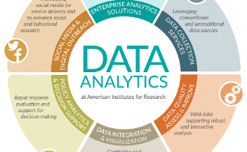
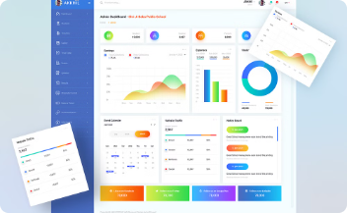
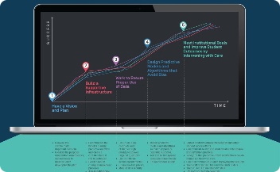
Driving Data-Driven Decisions
Comprehensive Data Integration
Actionable Insights
Predictive Analytics
The JSM Control system seamlessly integrates data from various sources, including academic records, student information, financial transactions, and HR records. This centralized data repository enables universities to gain a holistic understanding of their operations and make informed, data-driven decisions.
The system's advanced analytics and reporting capabilities transform raw data into actionable insights, empowering university leaders to identify trends, detect anomalies, and make strategic decisions that optimize institutional performance and enhance the overall student experience.
By leveraging predictive analytics, the JSM Control system can forecast student enrollment, anticipate resource needs, and identify potential challenges, enabling universities to proactively address issues and implement targeted interventions to improve student outcomes and institutional effectiveness.

Slide 6




Enhancing the Student Experience
Personalized Schedules
Seamless Communication
Comprehensive Support
Transparent Grading
The system facilitates seamless communication between students, faculty, and administrative staff, ensuring that students can easily access information, raise concerns, and receive timely responses to their inquiries.
The JSM Control system provides students with access to a wide range of support services, including academic advising, career counseling, and mental health resources, enhancing their overall well-being and success.
The JSM Control system provides students with personalized academic schedules, allowing them to easily manage their course load, track their progress, and stay informed about important deadlines and events.
Students can access their grades and academic records through the JSM Control system, fostering transparency and enabling them to monitor their performance and identify areas for improvement.

Slide 7




Ensuring Scalability and Adaptability
Modular Design
Flexible Deployment
Continuous Improvement
The JSM Control system is designed with a modular architecture, allowing universities to easily scale up or down their operations, add new functionalities, and adapt to changing requirements without disrupting the core system.
The system can be deployed on-premises, in the cloud, or through a hybrid approach, providing universities with the flexibility to choose the deployment model that best suits their infrastructure, security, and budget requirements.
The JSM Control system is supported by a dedicated team of experts who continuously monitor industry trends, gather user feedback, and implement updates and enhancements to ensure the system remains relevant, efficient, and aligned with the evolving needs of the university.

Slide 8

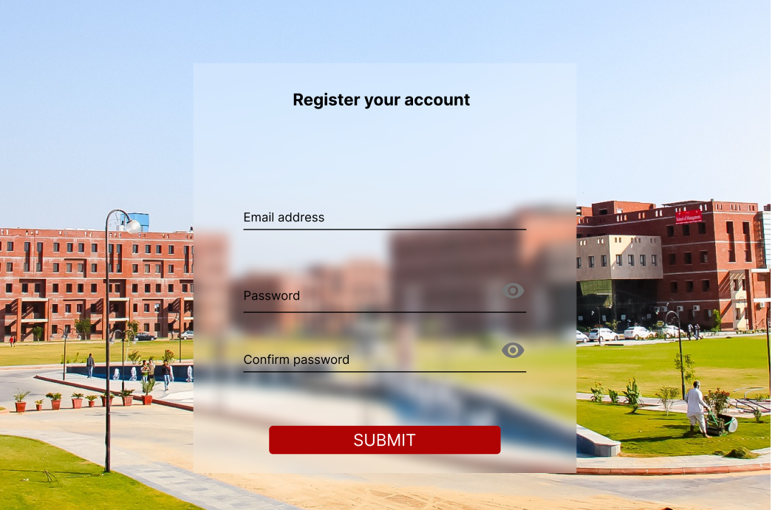
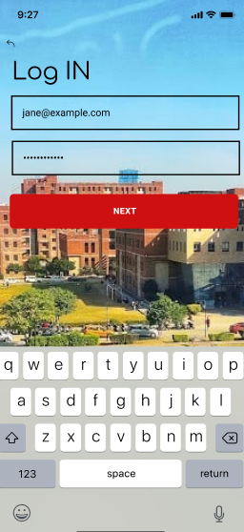
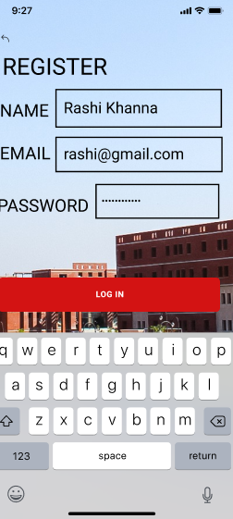
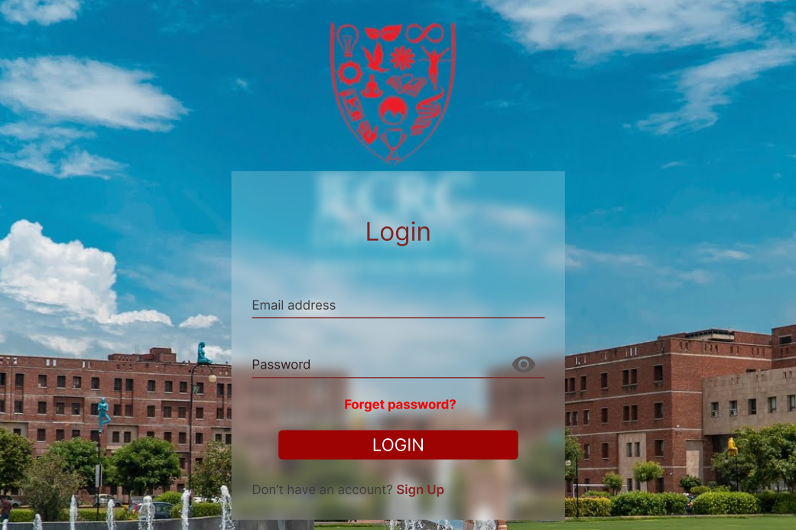
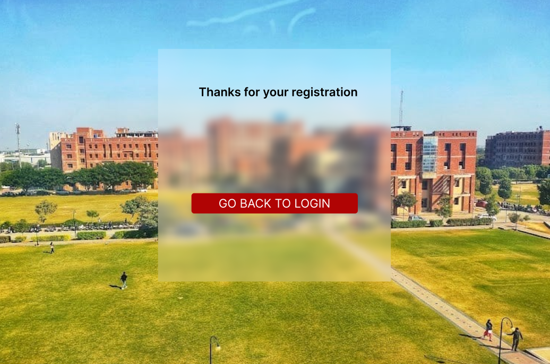
UI INTERFACE

Slide 9
Empowering Universities for the Future
The JSM Control system seamlessly integrates core business processes, enabling universities to streamline operations, enhance data-driven decision-making, and deliver a superior educational experience.
Comprehensive Integration
Adaptable and Scalable
The modular design and flexible deployment options of the JSM Control system allow universities to adapt to changing requirements and scale their operations as needed, ensuring long-term sustainability and growth.
Improved Stakeholder Engagement
By empowering students, faculty, and staff with real-time information, transparent processes, and enhanced communication channels, the JSM Control system fosters stronger engagement and collaboration across the university community.
Data-Driven Insights
The system's advanced analytics and reporting capabilities provide university leaders with actionable insights, enabling them to make informed decisions, optimize resource allocation, and drive continuous improvement.

